Slide 1
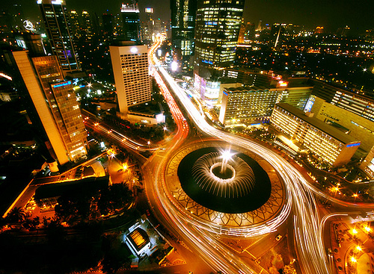

TRUCK & TRANSPORTATION in INDONESIA
Presented by:
Kyatmaja Lookman – Vice Chairman
Indonesia Truck Associations (ITA)
Asosiasi Pengusaha Truk Indonesia (APTRINDO)
Bangkok, July 2017

Slide 2

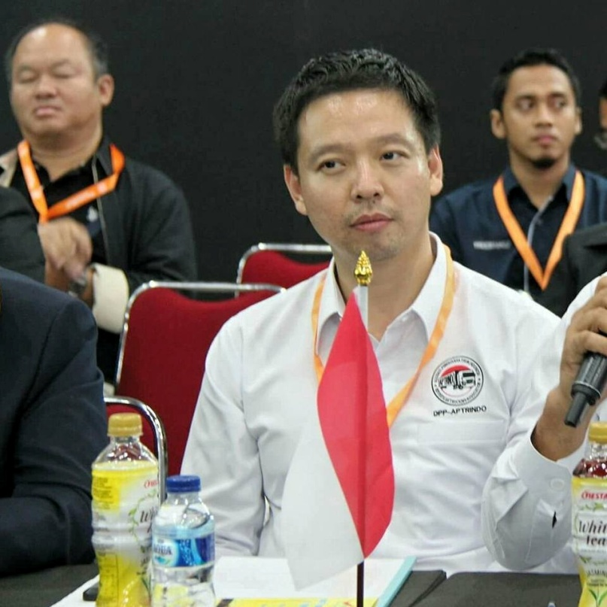
Resume: Kyatmaja Lookman
Formal Educations
2000- 2003 : Bcom in Business Strategy and Information System, UNSW, Sydney
2003- 2005. : MBA in Business Strategy, UTS, Sydney
Working Experiences
2002-2003, Bemboka, Director’s Assistant, Sydney
2003- 2004, Woolwoths, Grocery Assitant, Sydney
2003-2005, Megamart, Sales Consultant, Sydney
2005- present, Lookman Djaja Logistics, CEO, Jakarta
2014- present, Supply Chain Indonesia, Senior Consultant, Jakarta
2014- present, Lookman Djaja Land, CEO, Jakarta
2015- present, Certification Body forLogistics, LSP-LIP, CFO, Jakarta
2016- present, gudangbang.com, online warehouse, Chairman, Jakarta
2016- present, Trukkindo Jaya Bersama, CEO, Jakarta
Organizations
2014–present, Vice Chairman, Asosiasi Pengusaha Truk Indonesia APTRINDO/ Indonesian Trucking Association
2015-present, Compartment Head of Transportation, HIPMI – Indonesian Young Enterpreneurs
2016- present, Executive Vice President, JCI - Junior Chamber International East Java Chapter
2016- present, Vice Compartment of Logistics, KADIN, Indonesia Chamber of Commerce and Industry
2016–present, Compartment Head of Land Transport, ALFI/ILFA – Indonesian Logistics and Forwarder Association
Kyatmaja Lookman
Vice Chairman APTRINDO
Indonesia
kyatmaja@hotmail.com

Slide 3


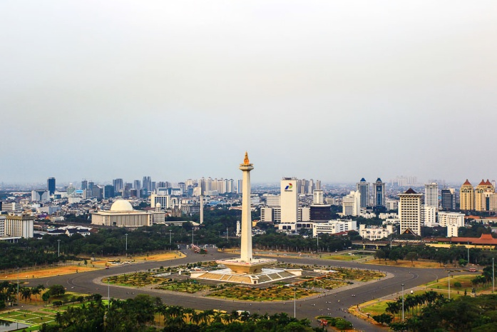
Indonesia Trucking Association
Indonesia at a Glance
Country name: Republic of Indonesia
Capital city : Greater Jakarta
Largest city : Greater Jakarta
Main Airport : Soekarno-Hatta International Airport
Cengkareng (CGK)
Main island : 5 islands (Sumatera, Java, Kalimantan,
Sulawesi and Irian).
Total islands : 13,000+ islands
Languages : Bahasa Indonesia
Currency : Indonesia Rupiah (IDR / Rp)
Population : 257,912,349 people (2017)
GDP per year: USD 1,014.9 billion (2017-estimate)
GDP Growth : 5.1% (2017)
GDP per Capita: USD.11,135 (2017)
Foreign workers from Asia in Indonesia (2016):
-China 15.341 people
-Japan 11.081 people
-South Korea 9.075 people
-India 6.047 people
-Malaysia 4.962 people
-USA 2,497
-Thailand: 500

Slide 4
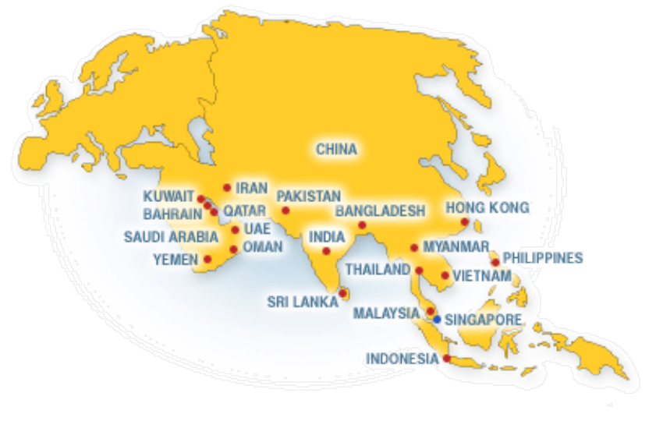
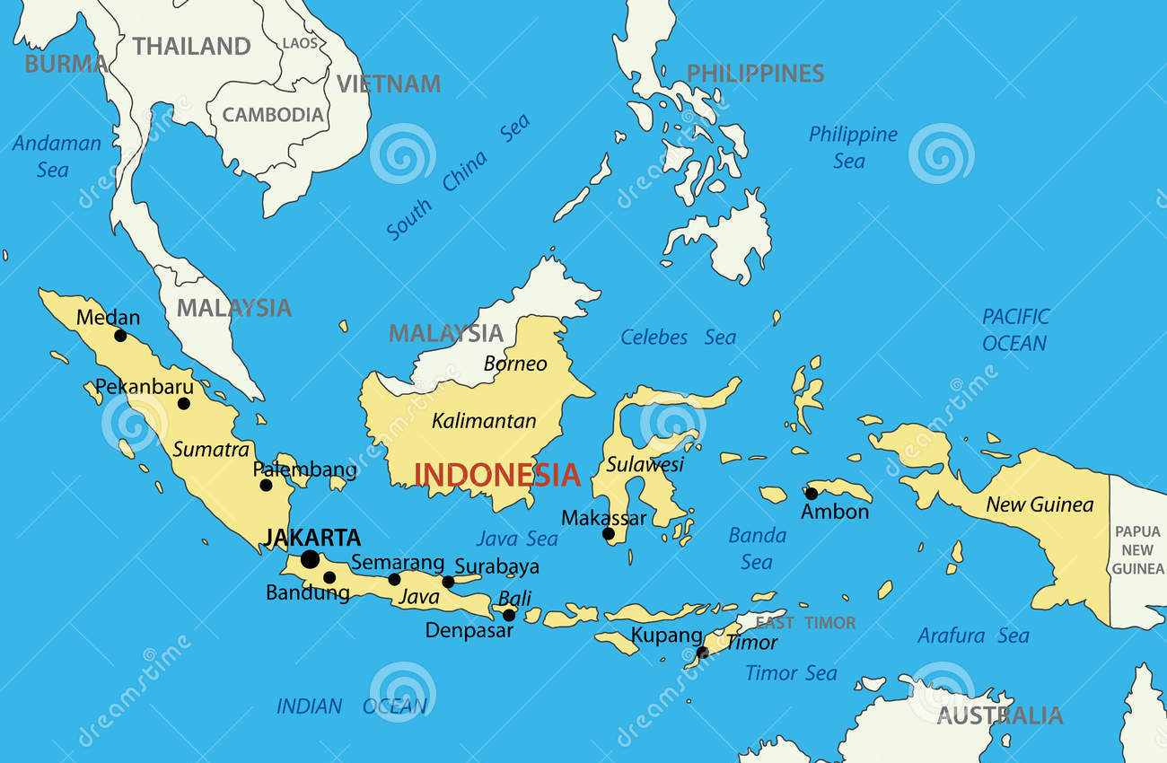

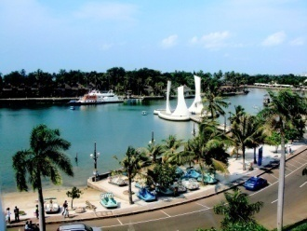
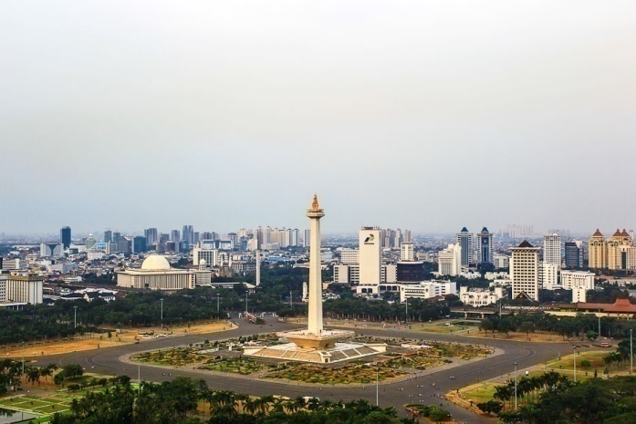
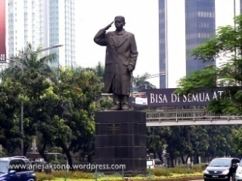



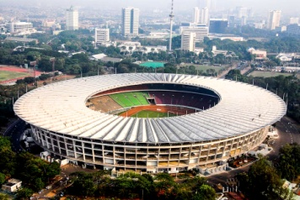
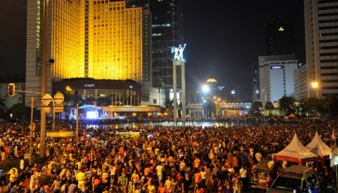
Indonesia Trucking Association
Territory

Slide 5

ITA/APTRINDO ROLE in INDONESIA
Internal Role
External Role
Helping the ITA/APTRINDO members to increase the competitiveness, better performance and more professional
Developing the freight transportation using the most effective and efficient truck
Serving and protecting the member’s interests and needs, accommodating the member’s suggestions
Canalizing and stand up for the member’s aspirations
Supporting all members to empowering and developing the professionalism
Supporting the member to develop the knowledge of logistics, freight transportations, Tax issues, managing the company, etc
Provide guidance and supervision in conducting business activities professionally in order to avoid the business practices that can harm other members
Helping the Central and Local Government in making:
  -Policies and regulations relating to the transport of goods by truck
  -Help control and supervise the implementation of policies and regulations that have been issued by local and central government
Provide support of information and data for decision making purposes of local and central government
Fostering cooperation with Indonesia Chamber of Commerce (KADIN Indonesia) as the parent of economic organizations in Indonesia and other associations, including cooperation with large National/Small/Medium private enterprises and cooperatives
Fostering cooperation with Central and Local Government in the widest sense, including cooperation with State Own Enterprises, Educational Institutions, Research Institutions and other institutions

Slide 6



Indonesian
Transportation Potrait

Slide 7
Indonesian Transportation Potrait
Trucking company dominated by SME and Family Business
Maritime Country with 17000 Island
6.2 million trucks registered dominated with class 2 truck
  Indonesian Transportation still focus on Peer to Peer transportation
Fragmented Industry:
  no single company dominating the whole market [Biggest Company can own up to 2000 to 3000 Trucks]
150 Million People live in Java 30 Million in Sumatra, that’s where the economy concentrated 80% GDP
Java and Sumatra is dominated with Trucking Business and The other island is Sea Business
Indonesian Trucking dominating 97% Cargo transportation in Java and 90% Cargo Transportation in Indonesia
Industrial area concentrated in Java 70% and also 70% Concentrated in Jabodetabek

Slide 8
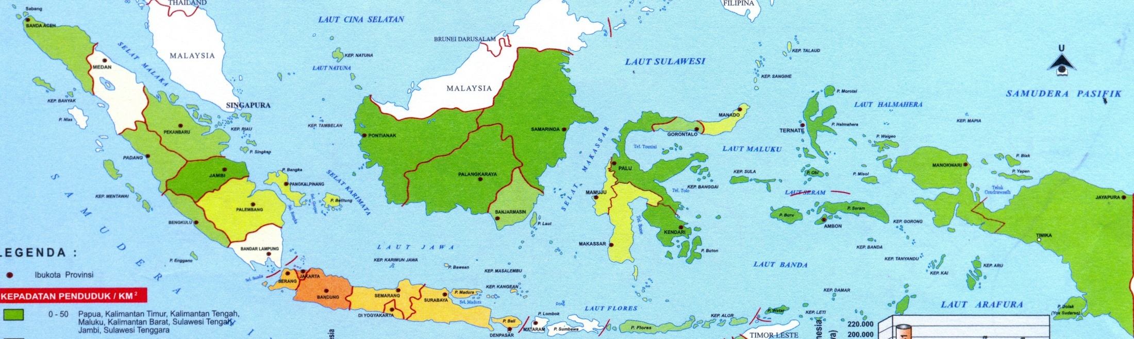
Indonesia Supply Network
8

Slide 9
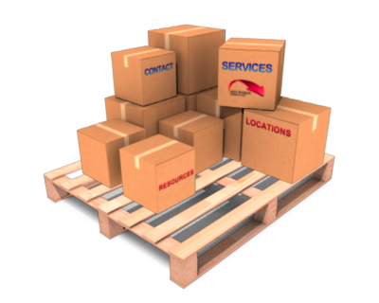



Challenges

Slide 10
Challenges
Human Capital
  Shortage of Good Driver
  Driving Truck is the last option job
    Long working hour (Jakarta- Surabaya 750Km, 36 Hours)
    Long Distance travel
    etc
  Mainly high school graduate
  No Truck Driver School: Driving Truck is skill learnt from being a helper or co-driver

Slide 11
Key Drivers Freight Transportation in AEC (%)
1st Human Capital (63.16%) and 2nd Information Technology (11.4%)
source : Supply Chain Indonesia (SCI) survey 2016

Slide 12
Challenges
Regulations [Conflicting regulations from Central to Local]
  Due to “Otonomi Daerah” [Regional Autonomy] each province and local government has different view of interpreting the law
  As a result too many Decree leads to miss interpretation of the original Law and different rules and regulations in local government level

Slide 13
Freight Road Transport Regulations
INDONESIAN LAW No. 22 YEAR 2009 ABOUT TRAFFIC AND ROAD TRANSPORTATION REGULATIONS
PRESIDENT DECREE NP. 74 YEAR 2014 ABOUT ROAD TRANSPORTATION
DIRECTOR GENERAL OF LAND TRANSPORT DECISION NUMBER: SK.725/AJ.302/DRJD/2004 ABOUT DANGEROUS GOODS REGULATIONS
DIRECTOR GENERAL OF LAND TRANSPORT DECISION NUMBER: SK.4428/AJ.003/DRJD/2012 ABOUT HEAVY CARGO REGULATIONS
MINISTRY OF TRANSPORTATION DECISION KM. 69 YEAR 1993 ABOUT ROAD TRANSPORTATION ESTABLISHMENT
1
2
3
4
5

Slide 14


Operational Permit
Central Government Regulations
Local Government Regulations

Slide 15
Challenges
Lack of Road Infrastructure Network
  Bad Traffic Congestion due to exponential growth of private vehicle (Low Cost Green Car) and also motorcycle
  Bad Road quality and drainage
  Lack of good infrastructure lead to different road class in National Road
  National Road suppose to be class 1 road with MST/ Max Axle Load of 10 Metric Tonne
  Due to budget limitation MST / Max Axle Load10 MT only in Java North Coast Road the Rest still dominated by class 2 road with MST / Max Axle Load 8 MT

Slide 16
Jenis Kendaraan Bermotor | Mobil Penumpang | Mobil Bis | Mobil Barang | Sepeda motor | Jumlah
1980 | 639464 | 86284 | 473831 | 2671978 | 3871557
1981 | 719336 | 113509 | 589439 | 3207499 | 4629783
1982 | 791019 | 134430 | 657104 | 3764442 | 5346995
1983 | 862424 | 160260 | 717873 | 4135677 | 5876234
1984 | 972148 | 191654 | 790881 | 4556095 | 6510778
1985 | 989158 | 227304 | 845338 | 4794517 | 6856317
1986 | 1063959 | 256574 | 882331 | 5118907 | 7321771
1987 | 1170103 | 303378 | 953694 | 5554305 | 7981480
1988 | 1073106 | 385731 | 892651 | 5419531 | 7771019
1989 | 1182253 | 434903 | 952391 | 5722291 | 8291838
1990 | 1313210 | 468550 | 1024296 | 6082966 | 8889022
1991 | 1494607 | 504720 | 1087940 | 6494871 | 9582138
1992 | 1590750 | 539943 | 1126262 | 6941000 | 10197955
1993 | 1700454 | 568490 | 1160539 | 7355114 | 10784597
1994 | 1890340 | 651608 | 1251986 | 8134903 | 11928837
1995 | 2107299 | 688525 | 1336177 | 9076831 | 13208832
1996 | 2409088 | 595419 | 1434783 | 10090805 | 14530095
1997 | 2639523 | 611402 | 1548397 | 11735797 | 16535119
1998 | 2769375 | 626680 | 1586721 | 12628991 | 17611767
1999 | 2897803 | 644667 | 1628531 | 13053148 | 18224149
2000 | 3038913 | 666280 | 1707134 | 13563017 | 18975344
2001 | 3189319 | 680550 | 1777293 | 15275073 | 20922235
2002 | 3403433 | 714222 | 1865398 | 17002130 | 22985183
2003 | 3792510 | 798079 | 2047022 | 19976376 | 26613987
2004 | 4231901 | 933251 | 2315781 | 23061021 | 30541954
2005 | 5076230 | 1110255 | 2875116 | 28531831 | 37623432
2006 | 6035291 | 1350047 | 3398956 | 32528758 | 43313052
2007 | 6877229 | 1736087 | 4234236 | 41955128 | 54802680
2008 | 7489852 | 2059187 | 4452343 | 47683681 | 61685063
2009 | 7910407 | 2160973 | 4498171 | 52767093 | 67336644
2010 | 8891041 | 2250109 | 4687789 | 61078188 | 76907127
2011 | 9548866 | 2254406 | 4958738 | 68839341 | 85601351
2012 | 10432259 | 2273821 | 5286061 | 76381183 | 94373324
2013 | 11484514 | 2286309 | 5615494 | 84732652 | 104118969
2014 | 12599138 | 2398846 | 6235136 | 92976240 | 114209266
Indonesian Transportation Population by Year and Category of Vehicle
10

Slide 17
Challenges
Limited Number PDR (Regional Distribution Center)
  Manado, Makassar and Palembang

Slide 18
Challenges
Aging Technology and Fuel Quality
  Indonesian has no Age limitation on Truck Use
  Current Engine Emission rating is Euro 2
  Fuel has Max 20% Bio Fuel content (B20)
    Quality issue 5000ppm vs 50ppm for PertaDex
    Not possible implementing Common Rail System without modification of Fuel Filtration system and Injector also lessen the pressure of injector pump
  Subsidized Diesel Fuel
    CNG Application is not yet popular

Slide 19
Challenges
High Interest Rate
  Interest Rate 12% to 15% PA
  Very difficult to buy new trucks 26% of truck population is more than 20 Years Old, 20% between 10 to 20 years old
Source Indonesian Statistic Bureau Year 2014

Slide 20
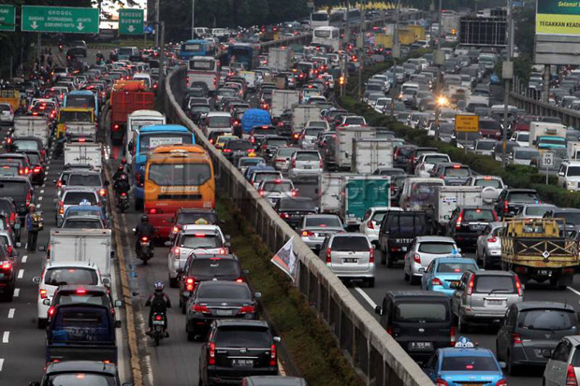
Challenges
Congestion lead to low Truck Utilization
  Indonesia Truck utilization 50.000 km PA
  Thailand Truck utilization 120.000 km PA
  Europe Truck utilization 200.000 km PA

Slide 21
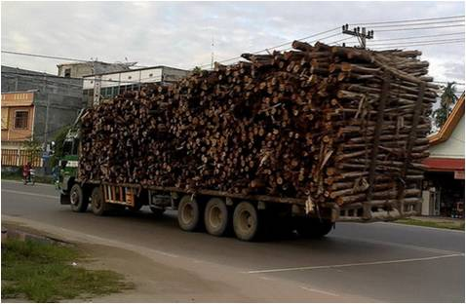
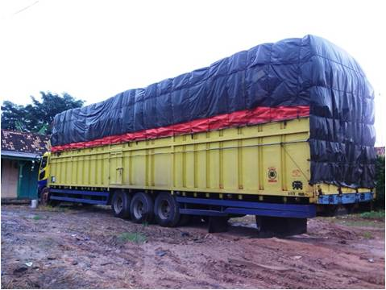
Challenges
Overloading and Over dimension
  Highly competitive market [Transport]
  Dominated with primary products and raw material
    High Transport Cost to Price Ratio
    Finished goods has much lower Transport Cost to Price Ratio e.g. Mobile Phones

Slide 22
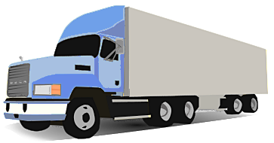
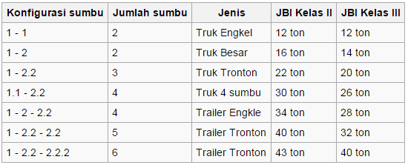
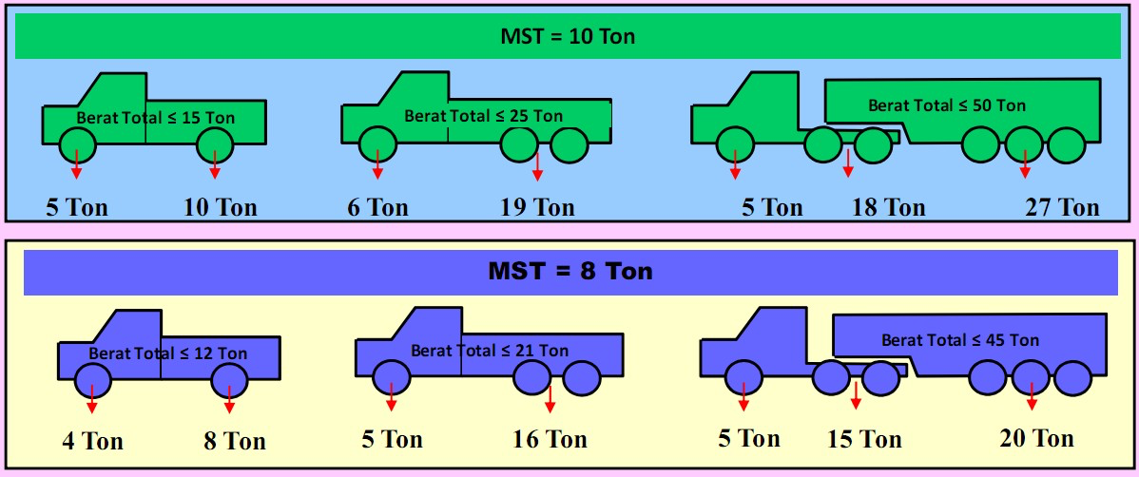
Truck Operational Guidelines
Gross Permit able Weight
Truck Operation Permit / 6 months
Axle Load / MST
Law No. 22 Yr 2009 No 19 :
Roads are classified into classes due to traffic intensity for the purpose of regulating traffic and also capacity of the road to handle maximum axle load (MST) and vehicle dimension

Slide 23


Opportunity

Slide 24
Opportunity
Driver Education
  Referring to AEC Agreement: Free Flow of Skilled Labor
    APTRINDO with 3 other Association ALFI and ASDEKI formed Certification Body for Driver in 2015
      Certification for Container Driver
      Certification for General Truck Driver
      Certification for Heavy Equipment Cargo Truck
      Certification for Dangerous Cargo Truck Driver
      Certification for Special cargo Truck Driver
    Currently we are in the process of developing Truck Driver School that will be available on each APTRINDO Regional Office
    Indonesian Bonus Demography (young and productive population 65%)

Slide 25
Opportunity
Information Technology
  APTRINDO and Telkom Indonesia are developing Trucking Database
    SIAB – Sistim Informasi Angkutan Barang
  Trucking Database is very important element for Trucking Identification and Driver Identification in Ports under IMO Charter [SOLAS]
  Currently approximately 10000 Trucks and drivers already registered in SIAB
  Application of SIAB:
    Maximize truck utilization through reduction in empty backhaul through system called LONTAR – Logistik Pintar [Smart Logistic]
    Connecting with Directorate General of Custom System to reduce Dwelling Time and most importantly Lead Time Door to Door
    Driver certificate Registration and Monitoring
    Driver Track Record Monitoring and many more

Slide 26
Opportunity
Harmonization and Simplification of Regulations from central to local government
  Under Presiden Jokowi Administration, The Government is fully committed to delete Local Government decree that conflicting with the central Government policy (more than 3000 local Government decree is deleted) to improve ease of doing business
  Weigh Scale and Terminal currently under local government will be handled by Central government in January 2017

Slide 27
Opportunity
Road Infrastrucure
  Under President Jokowi Adminstration, Government is focusing on developing toll road across Indonesia starting with
    Tol Trans JAVA that will be finised in 2019
    Tol Trans Sumatra Started
    Tol Trans Kalimantan, Sulawesi and Papua
  With better Road Infrastructure will enable Trucking company to use bigger Trucks Category 4 and 5 to further improve National competiveness and reduce cost
  More Road Infrastructure to reduce congestion
Mass Transportation development:
  Rail Network Development outside Java
  Sea TOLL and Short Sea Shipping
Private Regional Distribution Network collaboration with Ministry of Trade

Slide 28
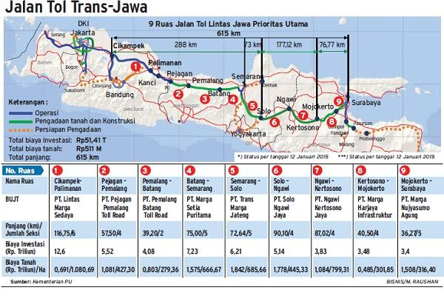

Slide 29
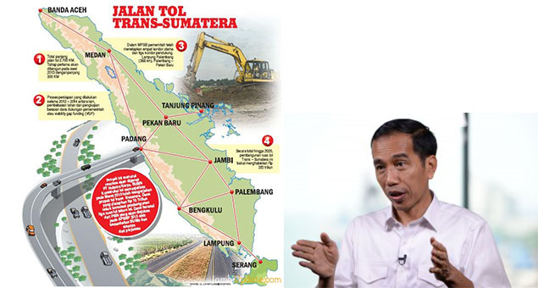

Slide 30
Opportunity
Formulating Better Indicator to Compare Freight Trucking Cost between ASEAN Countries
  Developing NEW indicator for truck LTI [Land Transport Index]
  Trucking cost is cheap yet Truckers is still blamed for the worsen LPI [Logistic Performance Index]
Logistics Performance Index (LPI) Indonesia* :
  2007 : 43 (V 53, P 65, T 31, M 27, S 1)
  2010 : 75 (V 53, P 44, T 35, M 29, S 2)
  2012 : 59 (V 53, P 52, T 38, M 29, S 1)
  2014 : 53 (V 48, P 57, T 35, M 25, S 5)
  2016 : 63 (V 64, P 71, T 45, M 32, S 5)
  Source: World Bank

Slide 31
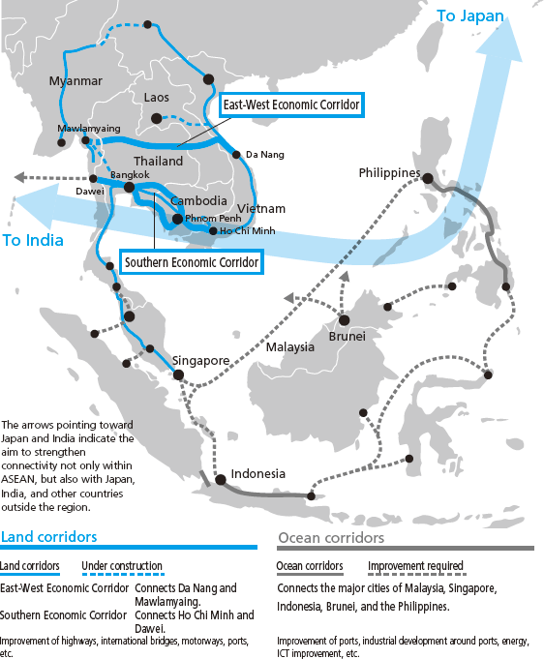
Cross Border Logistics
Land
  Malaysia (Serawak) – West Kalimantan (Pontianak)
  Malaysia (Sabah) – North Kalimantan
  Timor Leste – East Nusa Tenggara (Kupang)
  Papua New Guinea – West Papua
Sea
  Philippines (davao) – North Sulawesi (Manado)
  Malaysia (Malacca) – Riau (Dumai)
  Malaysia (Penang) – North Sumatra (Belawan)

Slide 32
Cross Border Logistics
Different Port Different Import Permit
Many Stakeholders
  Customs
  Immigrations
  Ministry of Transport
  Ministry of Trade
  No of Ministries according to the cargo
  Indonesian Police force
  etc

Slide 33
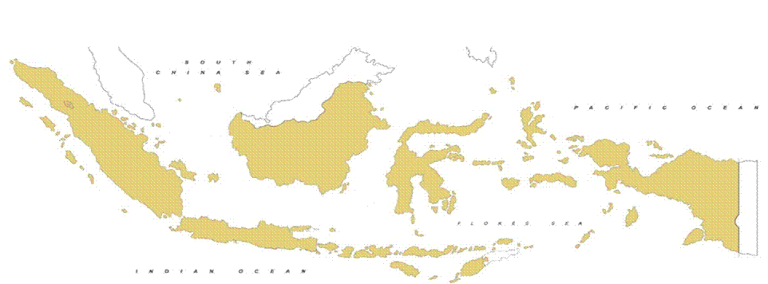
Backbone Future Logistic
“WAWASAN NUSANTARA”
Global Hub Port Front Line West
KUALA TANJUNG
Global Hub Port Front Line East
BITUNG
east-west 5200 KM
KUALA NAMU
Nort-south 1900 KM
HASANUDIN
GMT + 7
GMT + 8
GMT + 9
MAIN GLOBAL HUB PORT
MAIN INTERNATIONAL AIRPORT

Slide 34
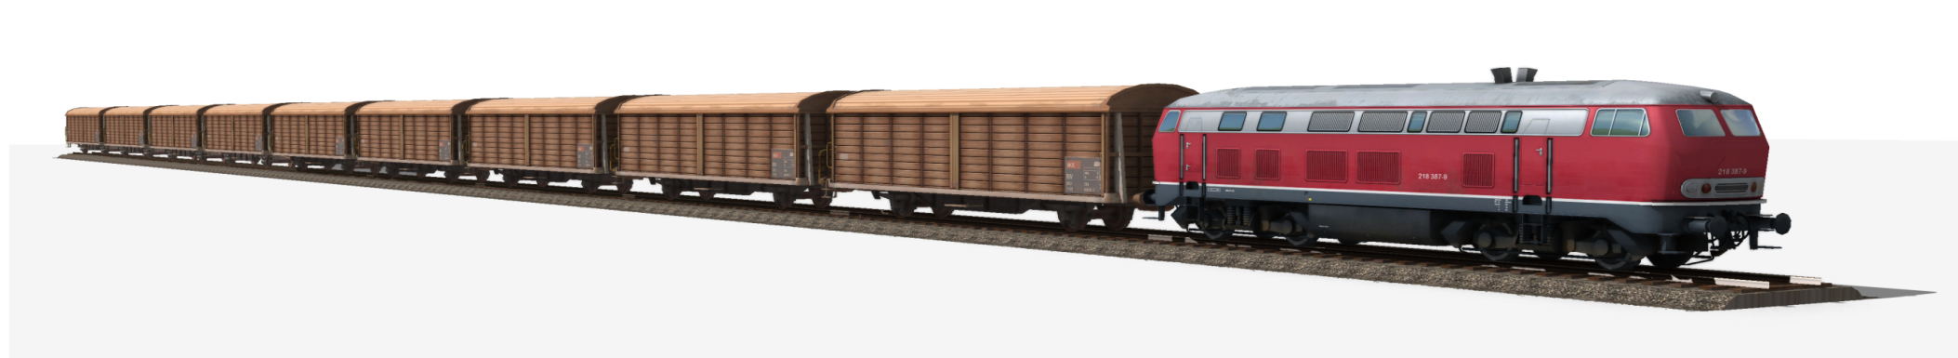




ThAnK yOu
  https://www.facebook.com/kyatmajalookman
  https://www.facebook.com/CV.LookmanDjaja
  http://id.linkedin.com/in/kyatmaja
  https://twitter.com/kyatmaja

